Slide 1
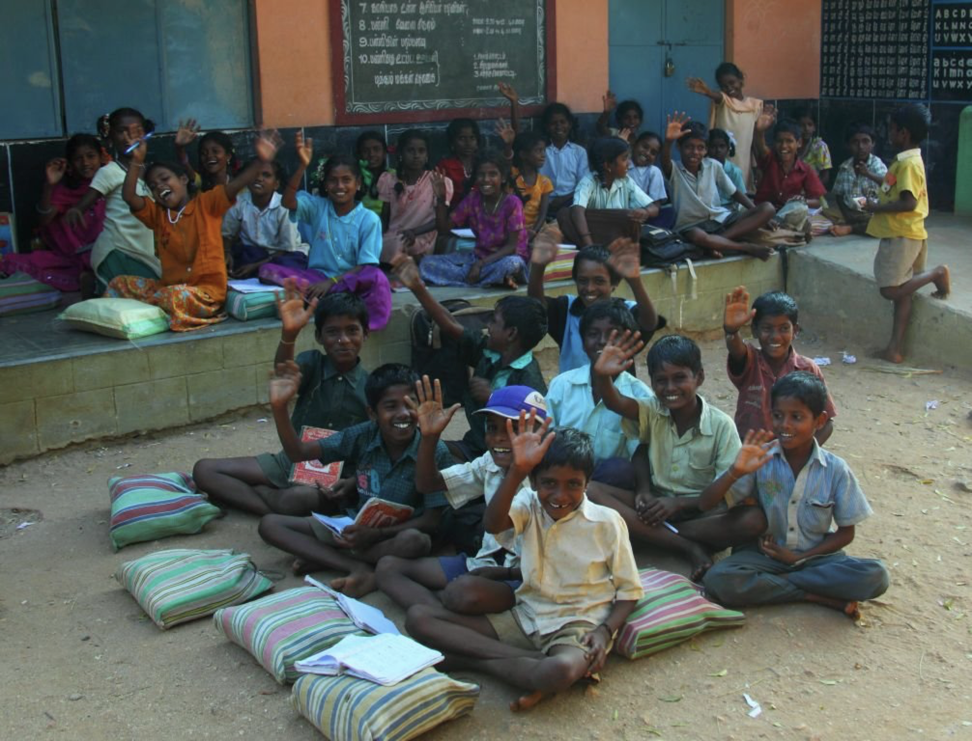
WEB APPLICATION DEVELOPMENT
Walk with a Book
Notes:
Good morning everyone, This is Anirudh Jakhotia n I would like to present today our web application idea. The title of our web application project is “Walk with a book”. Let’s start with the presentation.

Slide 2
Group No: 30
Group Leader:
Anirudh Jakhotia
Group members:
Neeraj Dusa
Harish Mullagura
Rakesh Ganeshula
Jayanth Sri Ram Kanduri
Duration: 6-7 hours per week
Notes:
Our Group No:30. I am the group leader for this project. Let me introduce you to the Group members of our project. We have Neeraj, Harish, Rakesh, and Jayanth. Each one of us will clearly explain all the aspects of the project as I move on. We decided to dedicate an ample amount of 6-7 hours per week to finish the project completely with great features. Let me first start with Project motivation.

Slide 3
Project Motivation
The main motivation of the project is to help the poor by giving books for free.The primary focus will be to help the poor,but it will also be helpful to other people as well.
Notes:
Project Motivation
The main motivation of the project is to help the poor by giving books for free.The primary focus will be to help the poor,but it will also be helpful to other people as well.

Slide 4
Problem Statement
Problem Solution
In these present situations, it is difficult for poor people to even afford food,thus affording money for buying books has become a big burden for their child's education!!
This website will play a major role in giving books to the poor for free which will be very helpful for them.
Notes:
Problem Statement
In these present situations, it is difficult for poor people to even afford food,thus affording money for buying books has become a big burden for their child's education!!
Problem Solution
This website will play a major role in giving books to the poor for free which will be very helpful for them.

Slide 5
Functional Description
Modules : 8
Module 1-Blueprint: We will first create a blueprint of our website on a paper.
Module 2-Web Design: We will start designing our website using HTML, CSS and JS and Python for Home page (front end).
Notes:
……………………...
Module 1-Blueprint: We will first create a blueprint of our website on a paper
So that we can have a clear overview of our website
Module 2-Web Design: We will start designing our website using HTML, CSS, JS and Python for Home page (front end) at the starting according to the outline of the website

Slide 6
Module 3-Prototype: We will design a login pop up window and after logging in, the user will find options in the page (Donate books/Buy books/Hall of fame).
Notes:
……………………...
Module 3-Prototype: We will design a login pop up window and after logging in where we will attach google and facebook accounts. The user will find options in the page (Donate books/Buy books/Hall of fame) by which the user must choose a particular option and go ahead

Slide 7
Module 4-Client Needs: On choosing
“Buy books” will redirect to a page where there will be a book shelf along with a filter and a search bar. So, the user can select the desired books and add them to the cart.
“Donate books” will redirect to a page where the donors should fill up the details like the name and address.
“Hall of Fame” will redirect to a page where top donors are listed in leaderboard with the number of books donated and can search donors by their donation ID.
Notes:
……………………...
Module 4-Client Needs: On choosing
“Buy books” will redirect to a page where there will be a book shelf along with a filter and a search bar. So, the user can select the desired books and add them to the cart and next you will be redirected to card and finally payment gateway
“Donate books” will redirect to a page where the donors should fill up the details like the name and address.
“Hall of Fame” will redirect to a page where top donors are listed in leaderboard with the number of books donated and can search donors by their donation ID.

Slide 8
Module 5-Database management:
By using MongoDB,we will connect to the database and maintain user records.
Module 6-Tracking: In this module, we will have a payment gateway and order tracking.
Notes:
In this module

Slide 9
Module 7-Testing: We will test our website for 2-3 weeks before deploying
Module 8-Deployment: This is the last stage, where we will deploy the website with no bugs

Slide 10
Project Overall Idea: People who want to donate their books can login to this website and can fill in the details of the book like name,genre and condition of the book. If the book is in good condition to read,then he has to give his address and then a pick up guy comes to receive it. Donors get the points or coupons which will be helpful to buy books from website with low cost!! The book will be posted on the website with title, edition, proper photo and grade of the book. Customers who are interested to buy the book can place an order with only delivery charges and order will be received as soon as possible and customers can keep track of order and can contact customer care for any further queries and updates.
Notes:
Project Overall Idea: People who want to donate their books can login to this website and can fill in the details of the book like name,genre and condition of the book. If the book is in good condition to read,then he has to give his address and then a pick up guy comes to receive it. Donors get the points or coupons which will be helpful to buy books from website with low cost!! The book will be posted on the website with title, edition, proper photo and grade of the book. Customers who are interested to buy the book can place an order with only delivery charges and order will be received as soon as possible and customers can keep track of order and can contact customer care for any further queries and updates.
If any damage to book in process of shipment,book can be easily exchanged or returned upon taking 2-3 days for refund.After getting the product user can write the feedback in the website

Slide 11
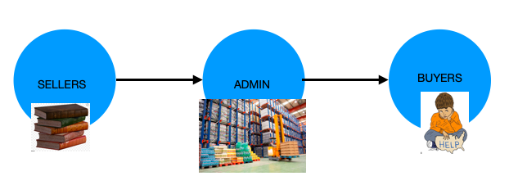
Primary Blueprint
Notes:
……………………...
Primary Blueprint
SELLERS WILL COME TO OUR WEBSITE AND FILL UP DETAILS LIKE NAME,ADDRESS,PHONE NUMBER AND QUANTITY OF BOOKS.
AND WE ALLOCATE A PICKUP DATE. ON THAT DAY, A DELIVERY GUY WILL PICKUP THE BOOKS FROM SELLER AND BRING THEM TO OUR GODOWNS. THE PEOPLE IN THE GODOWN WILL UPDATE THE DETAILS OF THE BOOK IN OUR WEBSITE LIKE NAME OF THE BOOK, AUTHOR, CLASS FOR WHICH THE BOOK BELONGS. NOW The BUYERS CAN COME TO OUR WEBSITE AND ORDER THEIR BOOKS FROM OUR WEBSITE.

Slide 12

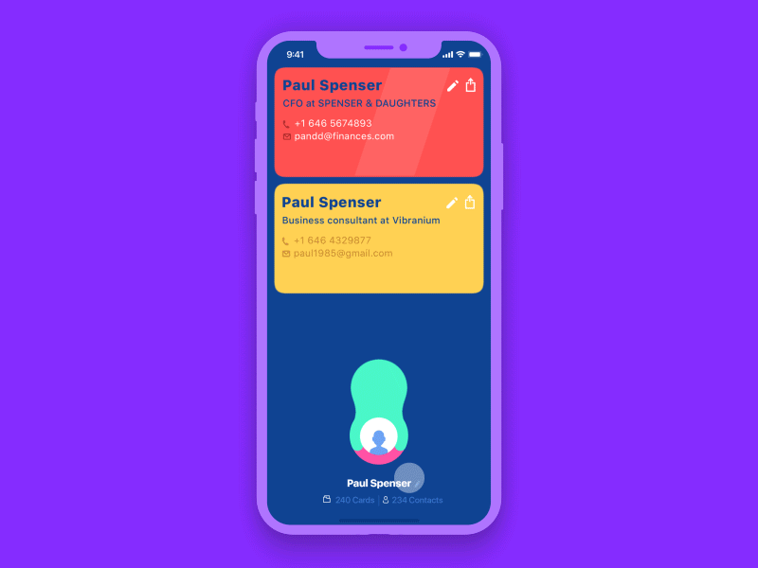
FEATURES
Better UI / UX
Easy Usage
Notes:
Better UI / UX
it is the feature that every website should be born with and it is the first attraction
Easy Usagethe usage will be straightforward for a common man to navigate

Slide 13

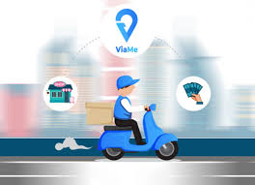
Cash on Delivery
Clean navigational menu
Notes:
Cash on Delivery
Clean navigational menu

Slide 14

Good quality product photos with image zoom and thumbnails
Notes:
Good quality product photos with image zoom and thumbnails

Slide 15

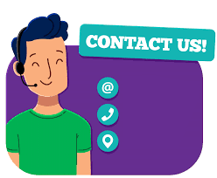

Wish-list and Add to cart
Engaging and informative “About Us” page with contact details.
Notes:
Wish-list and Add to cart
Engaging and informative “About Us” page with contact details.

Slide 16

Social media connections
Notes:
Social media connections

Slide 17


Suggestions and user feedback is taken
Notes:
Suggestions and user feedback is taken

Slide 18

Secure Login and User information is safe
Notes:
Secure Login and User information is safe
So with this u have completed features

Slide 19
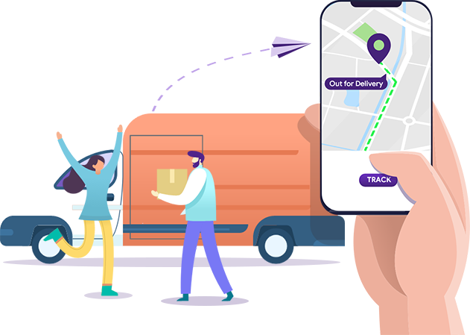
Further Updates
Tracking option for orders
Notes:
Further Updates
Tracking option for orders

Slide 20
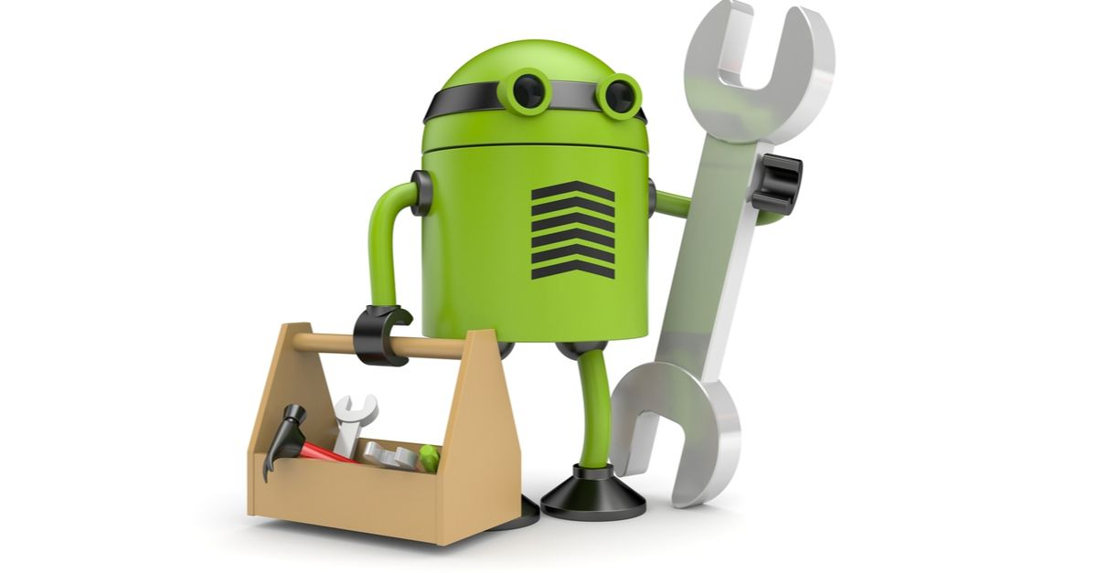
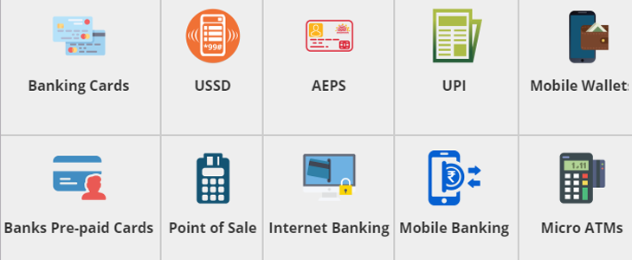
E-Payment
Bug fixes and performance
improvements
Notes:
E-Payment
Bug fixes and performance
improvements

Slide 21


Discount offers and coupons for Donors
Notes:
Discount offers and coupons for Donors

Slide 22
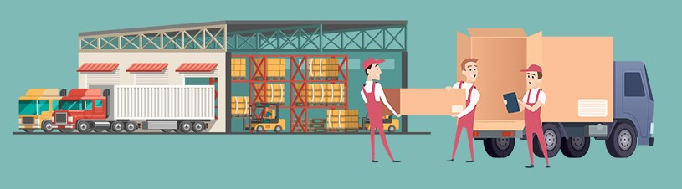
Will soon provide other products along with books
Notes:
Will soon provide other products along with books

Slide 23
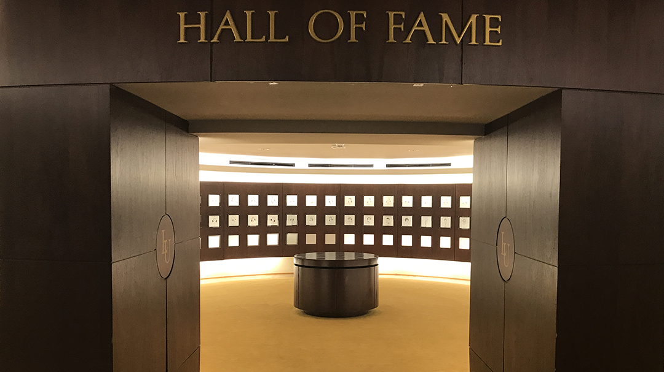
Connectivity
Hall of fame : The top 15 donors are posted in the Hall of Fame with their Name,photo and Contact information.
Notes:
Hall of fame : The top 15 donors are posted in the Hall of Fame with their Name,photo and Contact information.

Slide 24

Delivery can be reached for various possible places of India
Notes:
Delivery can be reached for various possible places of India

Slide 25
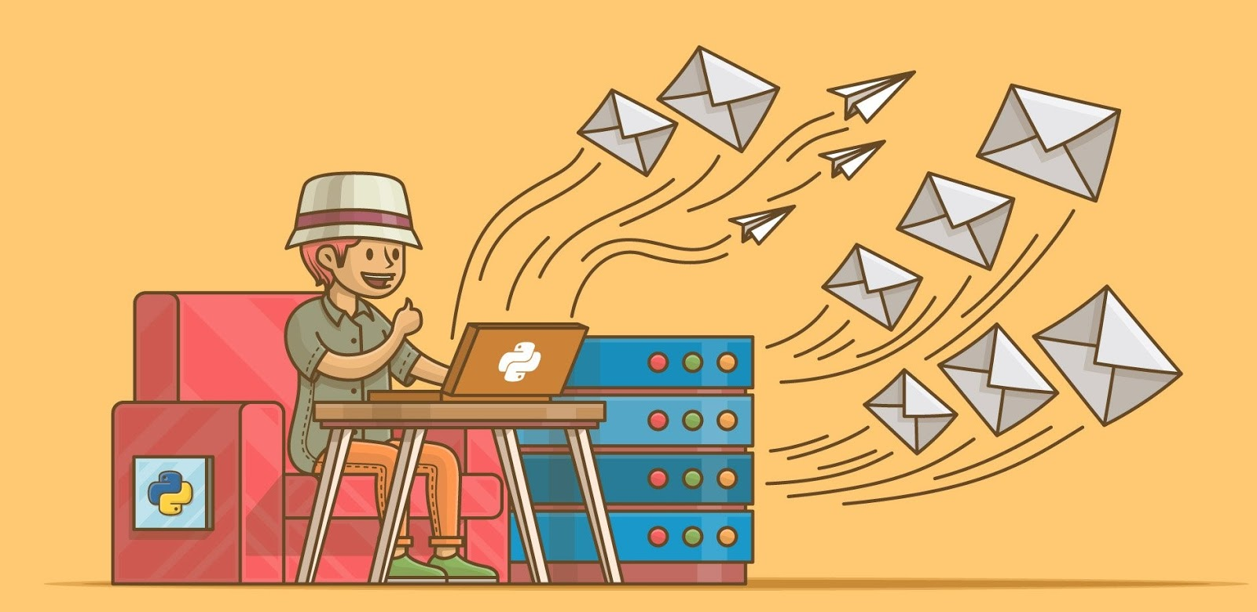
Sending email to Others
Can send a direct email for others to check about the website and can suggest a book and can interact with the Donors
Notes:
……………………...
Sending email to Others
Can send a direct email for others to check about the website and can suggest a book and can interact with the Donors.

Slide 26

QNA Queries
For any queries about the books and other details can ask questions and will be replied soon
Notes:
……………………...
QNA Queries
For any queries about the books and other details can ask questions and will be replied soon

Slide 27
Task Assigned
Anirudh Jakhotia : Graphic Designer and Security
Neeraj Dusa : Information Gathering and Catalogue management
Rakesh Ganeshula : Website Developer and payment gateway
Harish Mullagura : Database management and Tracking shipment
Jayanth Sri Ram Kanduri : UI/UX Designer, Manages bugs
Notes:
Jayanth Sri Ram Kanduri : UI/UX Designer, Manages bugs
So that it can be easy for users to go through the website at ease and take cares of delaying the bug problems and hanging problems

Slide 28
Software Components
HTML,CSS,JS,Python,Django,Bootstrap,
MongoDB Editor - VS Code
Web Browser - Google Chrome
Graphics Editor - GIMP,Adobe Photoshop
FTP Client - Filezilla
New Software components to be added for further development.
Notes:
Software Components
HTML,CSS,JS,Python,Django,Bootstrap,
MongoDB Editor - VS Code
Web Browser - Google Chrome
Graphics Editor - GIMP,Adobe Photoshop
FTP Client - Filezilla
New Software components to be added for further development.
And upon further requirements new software tools will be used.

Slide 29
Preliminary work
We will draw an outline of our website
We will search for most needed places first
We will tie-up with the delivery company
We will collab with other websites
We will initially collect few books as a catalog and provide them to the use
Notes:
We will draw an outline of our website
We will search for most needed places first
We will tie-up with the delivery company
We will collab with other websites
We will initially collect few books as a catalog and provide them to the use

Slide 30


ANY QUESTIONS?
Notes:
Thank u

